Slide 1

Project
Feed Forward
Fall 2023 TLDP Learning Accelerator Capstone

Slide 2

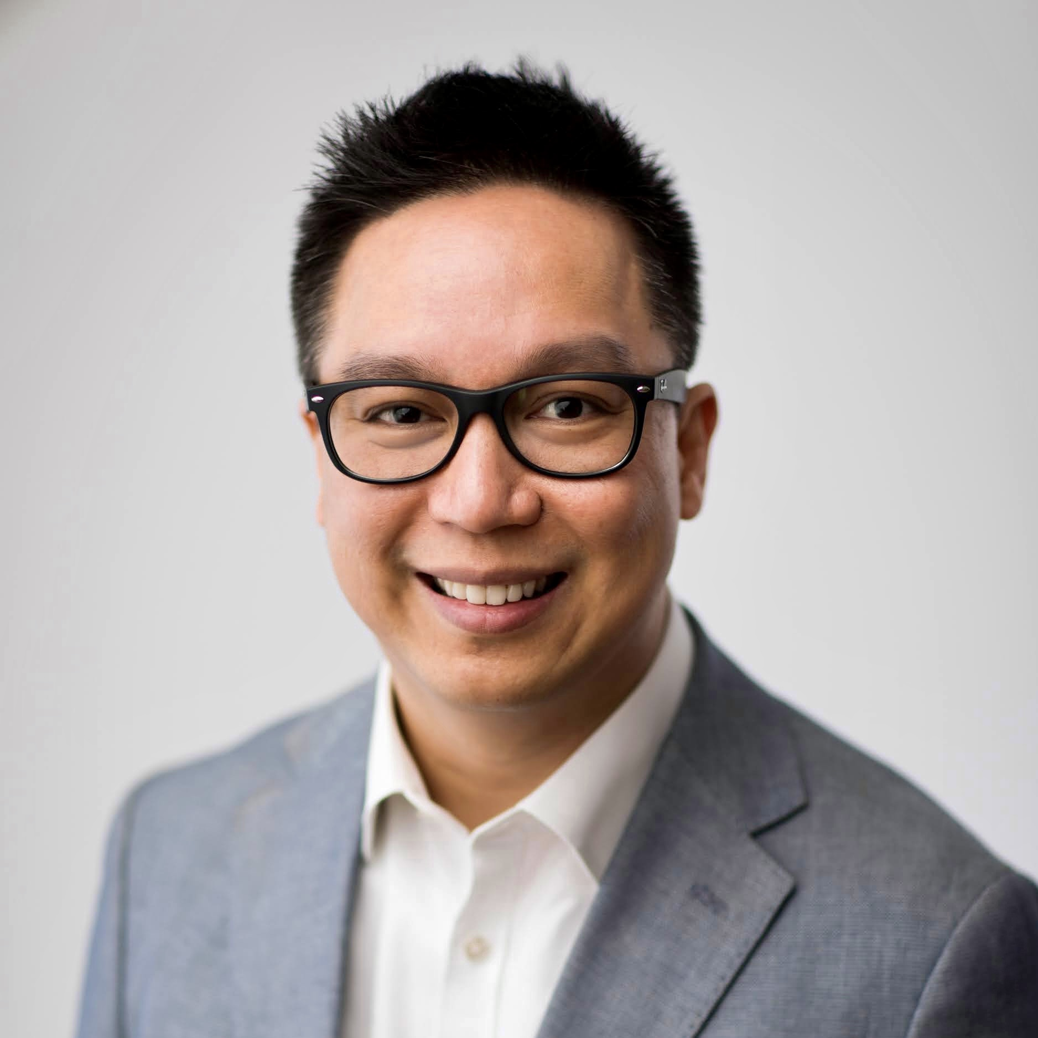
Annabelle Strong
Chris Rances
Team Mongods
TLDP SWE, PI Self-Service
TLDP SWE, PI Tech Data & Analytics

Slide 3
Introduction
Learned about the MERN stack
Full-stack, dynamic client-side web apps
Challenged to make employee feedback portal
Connect to direct reports
Built-in feedback loop
Sentiment analysis insights

Slide 4
Demo
Login Page
Authentication with backend
Home Page
List of incoming messages
Statistics of feedback valence
Managerial team list
Feedback submission form

Slide 5













Tech Stack
Frontend
Backend
Collaboration

Slide 6
AI Model
Objective: infer sentiment “valence” from text
Positivity scale of 1-5
Method: multiclass text classification model
SciKit Learn (sklearn) Multinomial Naïve Bayes
Uses dynamic probability to return likely class
Preprocessing: turned existing prelabeled employee review dataset into a matrix of word counts (“vectorization”)
Training: ran data through the model for it to learn word-sentiment correlations
Testing: evaluated model with accuracy metrics
For nerds: precision = .65, recall = .53, f1 = .51
For non-nerds: it did decently well, but not outstanding

Slide 7
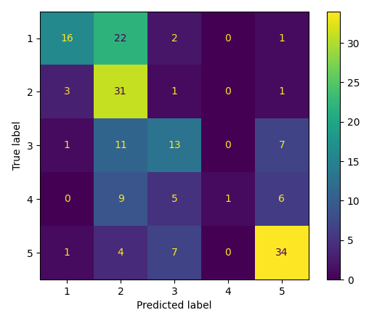
Challenges
Model accuracy
Not bad, but tried to improve
Data collection
Needed to use relevant prelabeled data for model, which took time to find and process
State management in React
Dynamic client-side nature makes session data tricky to persist
Time management
Who could’ve guessed it’s hard to make a full webapp in two days??
Model “confusion matrix”:
model predictions vs actual sentiment class

Slide 8

Extensions
Fine-tune model with actual user data and/or analyze other model selection options
Pretrained LLM (BERT, etc.), feed-forward neural net, or others
Build Jenkins pipeline for containerization, testing and deployment
Add sentiment data dashboard
wait that sounds familiar…

Slide 9
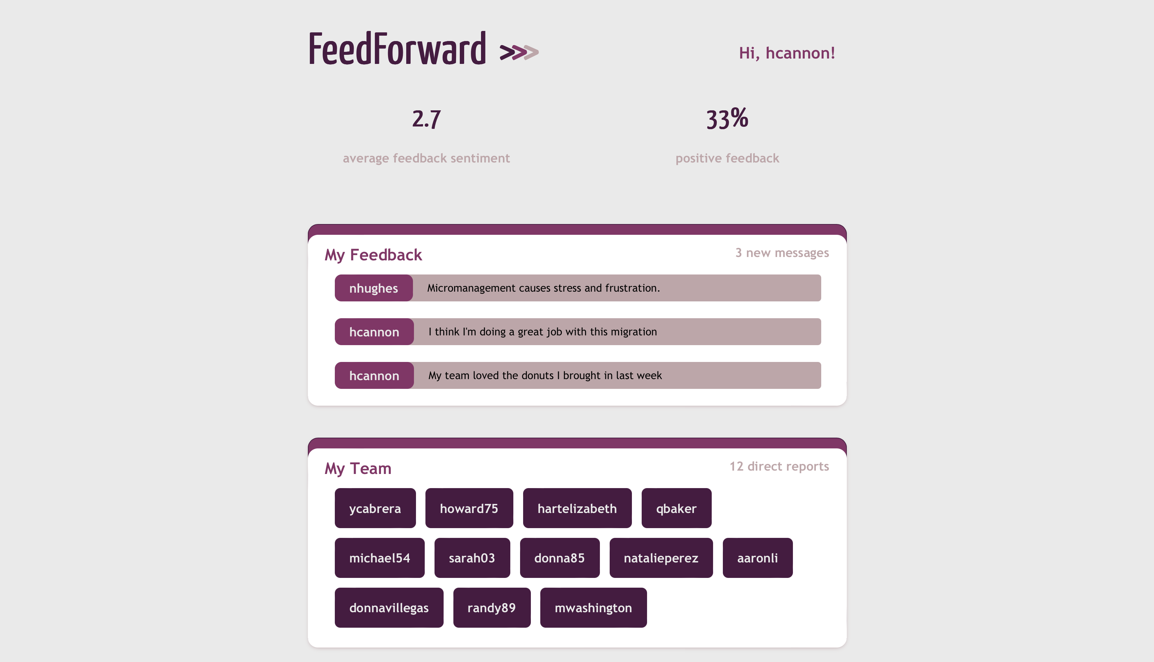
Questions?
“Good communication is the bridge between confusion and clarity”
Nat Turner

